Slide 1

Geometry
Unit 3, Lesson 6 Using Angle Relationships, Postulates, and Theorems Volume 1, pg. 154

Slide 2


Benchmark
MA.912.GR.1.1
Prove relationships and theorems about lines and angles. Solve mathematical and real-world problems involving postulates, relationships, and theorems of lines and angles.
volume 1, pg. 154

Slide 3
Integrated Mathematical Thinking and Reasoning Standards
MA.K12.MTR.1.1 Actively participate in effortful learning both individually and collectively.
MA.K12.MTR.4.1 Engage in discussions that reflect on the mathematical thinking of self and others.
MA.K12.MTR.5.1 Use patterns and structure to help understand and connect mathematical concepts.
volume 1, pg. 154

Slide 4

Learning Target
I can solve mathematical and real-world problems involving postulates, relationships, and theorems of lines and angles.
volume 1, pg. 154

Slide 5

Warm-Up
volume 1, pg. 154

Slide 6
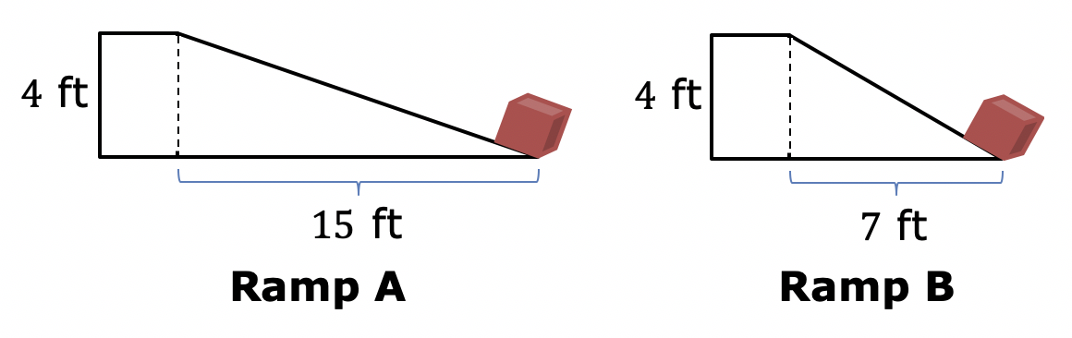
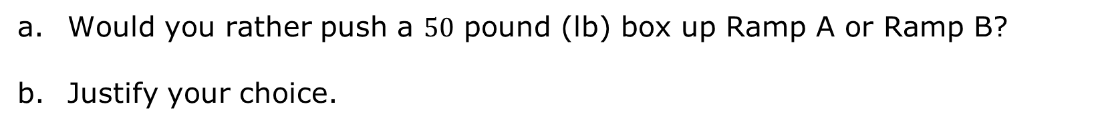
3.6.1 Warm-Up: Would You Rather?
Two ramps set up to move boxes up to a $4$ foot (ft) high platform are shown.
Would you rather push a $50$ pound (lb) box up Ramp A or Ramp B?
Justify your choice.
volume 1, pg. 154

Slide 7

Activity
volume 1, pg. 155

Slide 8

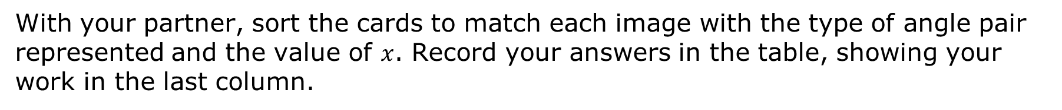
3.6.2 Activity: Solving Using Angle Relationships, Postulates, and Theorems
With your partner, sort the cards to match each image with the type of angle pair represented and the value of $x$. Record your answers in the table, showing your work in the last column.
Type of Angle Pair | Letter of Image | Work and Answer
volume 1, pg. 155

Slide 9
Type of Angle Pair | Letter of Image | Work and Answer
volume 1, pg. 155

Slide 10

Your Turn
volume 1, pg. 156

Slide 11
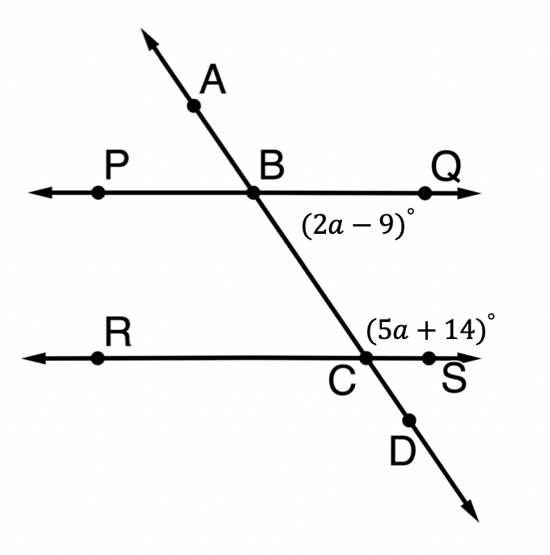
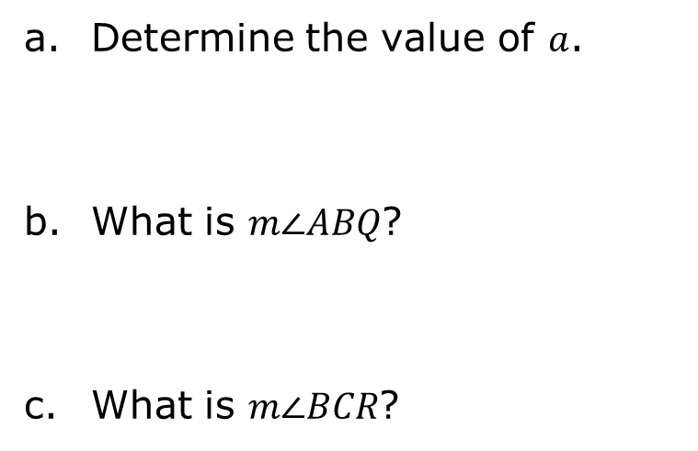
3.6.3 Your Turn!
$\overset{⃡}{PQ} ∥ \overset{⃡}{RS},$ where $\overset{⃡}{AD}$ is a transversal.
Determine the value of $a$.
What is $m∠ABQ$?
What is $m∠BCR$?
volume 1, pg. 156

Slide 12
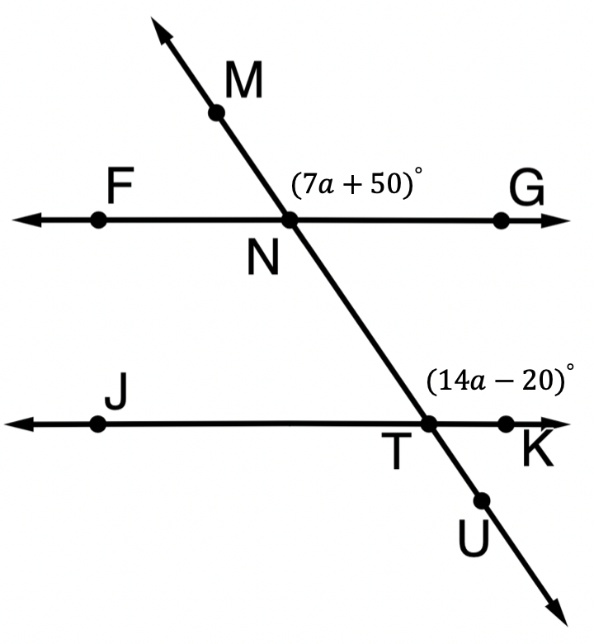

$\overset{⃡}{FG} ∥ \overset{⃡}{JK}$ where $\overset{⃡}{MU}$ is a transversal.
Determine the value of $a$.
What is $m∠FNT$?
What is $m∠KTU$?
volume 1, pg. 156

Slide 13
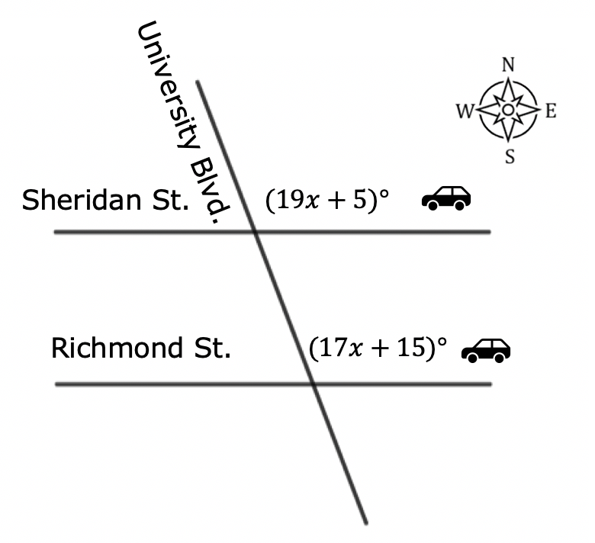
Sheridan Street and Richmond Street are parallel, and both are intersected by University Boulevard.
Two cars are heading west, one on Sheridan St. and one on Richmond St. Both cars turn north onto University Blvd. What is the measure of the angle of their turn onto University Blvd.?
volume 1, pg. 157

Slide 14

Wrap-Up
volume 1, pg. 157

Slide 15
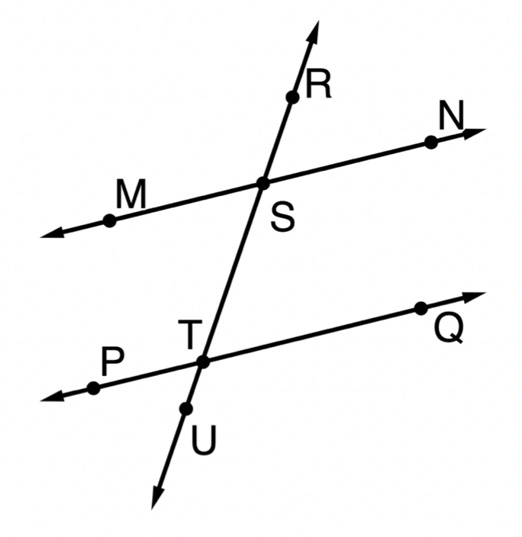

3.6.4 Wrap-Up: Ticket Out the Door
Given $\overset{⃡}{MN}∥\overset{⃡}{PQ}$, $m∠PTS=(14x−10)°$, and $m∠NST=(9x+35)°,$find each angle measure.
$m∠MSR$
$m∠STQ$
volume 1, pg. 157

